Slide 1
CS 2009 Design and Analysis of Algorithms
Waheed Ahmed
Email : waheedahmed@nu.edu.pk
Week 14.2:
NP-Completeness Reduction
Thomas H. Coreman (CLRS), Chapter 34.
JON KLEINBERG, EVA TARDOS, Chapter 8.

Slide 2
Reductions
Reduction is a way of saying that one problem is “easier” than another.
We say that problem A is easier than problem B, (i.e., we write “A ≤ B”)
if we can solve A using the algorithm that solves B.
Idea: transform the inputs of A to inputs of B
yes
α
f
β
Problem B
yes
no
no
Problem A

Slide 3
Polynomial Reductions
Given two problems A, B, we say that A is polynomially reducible to B (A ≤_{p} B) if:
There exists a function f that converts the input of A to inputs of B in polynomial time
A(i) = YES ⇔ B(f(i)) = YES

Slide 4
Polynomial Reduction
Polynomial time algorithm to decide A
yes
α
f
β
Polynomial time
algorithm to decide B
yes
no
no
Use a polynomial time reduction algorithm to
transform A into B
Run a known polynomial time algorithm for B
Use the answer for B as the answer for A

Slide 5
Implications of Reduction
Problem A reduces to problem B if you can use an algorithm that solves B to help solve A.
Cost of solving A = total cost of solving B + cost of reduction.
yes
α
f
β
Problem B
yes
no
no
- If A ≤_{p} B and B ∈ P, then A ∈ P
- if A ≤_{p} B and B ∉ P, then A ∉ P
Algorithm for Problem A

Slide 6
Reductions Examples
Problem A reduces to problem B if you can use an algorithm that solves B to help solve A.
Example 1. [finding the median reduces to sorting]
To find the median of N items:
Sort N items
Return item in the middle:
Cost of solving finding median = O(n log n) + 1
yes
α
f
β
Problem B
yes
no
no
Algorithm for Problem A
Cost of Sorting
Cost of Reduction

Slide 7
Reductions Examples
Problem A reduces to problem B if you can use an algorithm that solves B to help solve A.
Example 2. [element distinctness reduces to sorting]
To solve element distinctness on N items:
Sort N items
Check adjacent pairs for equality.
Cost of solving element distinctness = O(n log n) + O(n)
yes
α
f
β
Problem B
yes
no
no
Algorithm for Problem A
Cost of Sorting
Cost of Reduction

Slide 8
Reductions Examples
Convex hull. Given N points in the plane, identify the extreme points of the convex hull (in counterclockwise order).
Example 3. [Convex hull reduces to sorting.]
To solve convex hull:
Choose point p with smallest (or largest) y-coordinate.
Sort points by polar angle with p.
Consider points in order, and discard those that would create a clockwise turn.
Cost of solving element distinctness = O(n log n) + O(n)
yes
α
f
β
Problem B
yes
no
no
Algorithm for Problem A
Cost of Sorting
Cost of Reduction

Slide 9
RECIPE FOR PROVING PROBLEM Is NP-Complete
To Prove B Is NP-Complete
Prove that B is a member of the class NP. B ∈ NP
Choose an NP-complete problem A.
Prove that there is a Levin reduction from A to B.

Slide 10
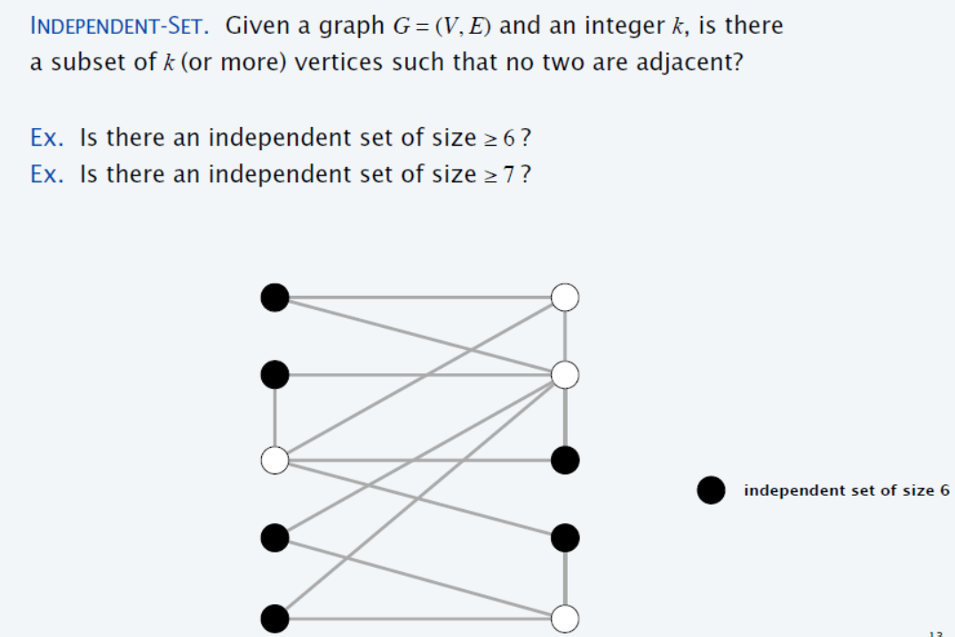
Independent Set (Example 1)
{1} is independent Set
{2, 3} is independent Set
{1, 3} is independent Set
{1, 3, 6} is independent Set
1
2
{2, 5, 6, 7} is independent Set
3
4
{1, 3, 6, 7} is independent Set
{1, 3, 6, 7, 8 , 9} is independent Set
5
6
7
8
9
10
Notes:
Independent-set set to Vertex Cover = V-Answer of Independent-set(S)

Slide 11
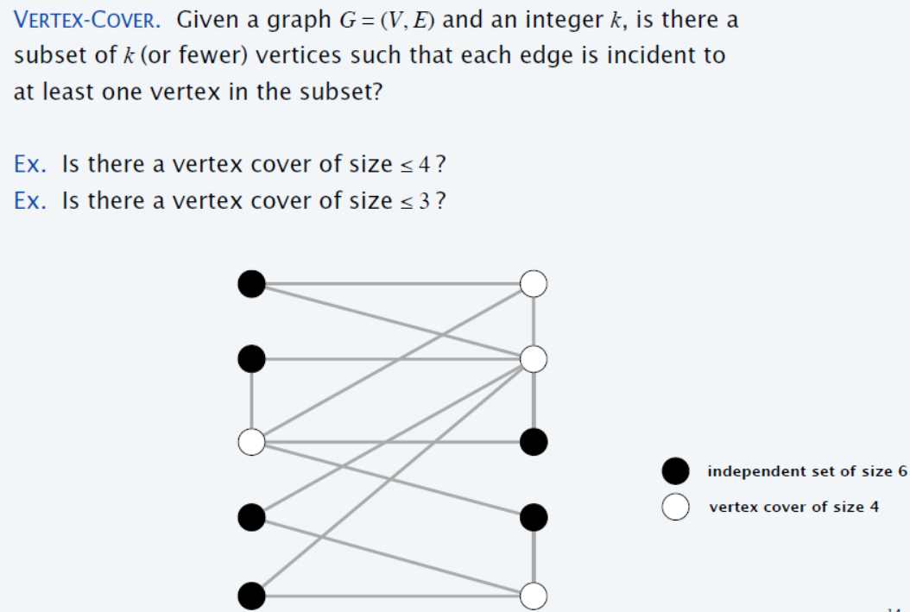
Vertex Cover (Example 1)
1
2
3
4
5
6
7
8
9
10

Slide 12
Vertex Cover is NP-Complete
Recipe to Prove a Problem Is NP-Complete
Prove that a Vertex Cover is NP-Complete
Step 1. Vertex Cover ∈ NP
Step 2. Choose an NP-Complete problem A (Independent Set).
Prove that A (Independent set) reduces to B (Vertex Cover)
INDEPENDENT-SET ≤_{p} VERTEX-COVER.
if we could solve the vertex cover problem in polynomial time,
then we would be able to solve independent set in polynomial time.
Notes:
We already have solution of Independent Set (Problem A), and we want to use the same solution of Problem A for Problem B (Vertex Cover), and this mapping of solution A to solution B (solution B needs to find out), must be in polynomial time)

Slide 13
Step 1: Vertex Cover ∈ NP
Given Graph G = (V, E) contains Vertex cover of Size 3?
S is vertex cover if every edge in E has at least one endpoint in S.
(Example S = {2,3,7})
In polynomial time we can verify that, for each edge (u, v) in E. Either u ∈ S, or v ∈ S, or both ∈ S
This can be done in O(n²) time.)
1
2
3
4
5
6
7
Notes:
We can verify in P-time

Slide 14
Vertex cover and independent set reduce to one another
Lemma: INDEPENDENT-SET ≤_{p} VERTEX-COVER.
Proof: We show S is an independent set of size k,
iff V − S is a vertex cover of size n – k.
Let S be any independent set of size k.
Consider an arbitrary edge (u, v) ∈ E.
S independent ⇒ either u ∉ S, or v ∉ S, or both ∉ S.
Vertex Cover (V-S)⇒ either u ∈ V − S, or v ∈ V − S, or both ∈ V − S.
Thus, V − S covers (u, v). ▪
2
S = {4,5}
4
5
7

Slide 15
Independent Set (Example 2)
S is independent if there are no edges between vertices in S.
(Example I.S = {1,4,5,6})
V.C = V – S
(V.C ={2,3,7})
1
2
1
2
VC = V - S
3
4
5
3
4
5
6
7
6
7
Notes:
Indepenset set to Vertex Cover = V-Answer of indepense set(V)
Compliment graph of indepenset set in cliqie

Slide 16
Clique (Example 2)
Clique
Graph G = (V, E), a subset S of the vertices is a clique if there is an edge between every pair of vertices in S. (Example Clique = {1,4,5,6})
2
1
Clique of size 4
3
4
5
6
7

Slide 17
Clique is NP-Complete
Recipe to Prove a Problem Is NP-Complete
Prove that a Clique is NP-Complete
Step 1. Clique ∈ NP.
Step 2. Choose known NP-Complete problem A (IS).
Prove that A (IS) reduces to B (Clique)
IS ≤_{p} Clique.

Slide 18
Step 1: Clique ∈ NP.
Graph G = (V, E), a subset S of the vertices is a clique if there is an edge between every pair of vertices in S. (Example Clique = {1,4,5,6})
Given graph contains Clique of size = 4 ?
In polynomial time we can verify that, for each pair of vertices u, v ∈ S, S= {1,4,5,6} there is edge between them. (In particular, if G is given as an adjacency matrix, this can be done in O(n²) time.)
2
1
3
4
5
6
7
Notes:
Every vertex of S contained each other. (Mesh Connected)

Slide 19
Step 2: IS ≤_{p} Clique
Lemma: S is Independent in G iff S is a Clique in the complement of G
To reduce IS to Clique, we compute the complement of the graph. The complement has a clique of size K iff the original graph has an independent set of size K.
Construction of Complement of the graph can easily be done in polynomial time.

Slide 20
IS ≤_{p} Clique (Example 2)
2
1
2
Complement
1
3
4
5
3
4
5
6
7
6
7
Independent-Set of Size 4
Clique of Size 4

Slide 21
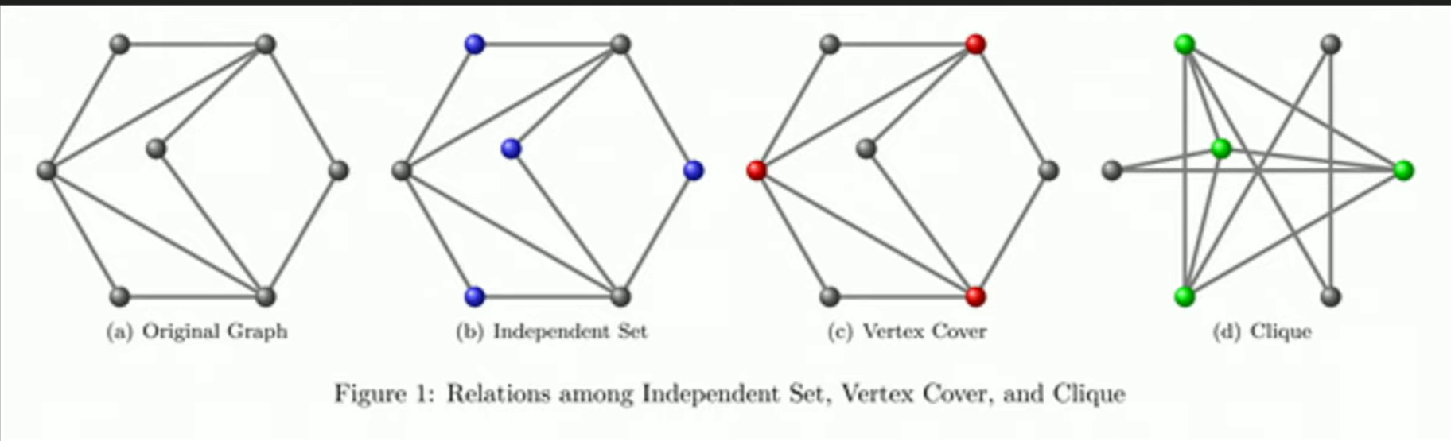
Reduction: Independent Set, Vertex Cover, and Clique (Example 3)

Slide 22
INDEPENDENT-SET is NP-Complete
Recipe to Prove a Problem Is NP-Complete
To prove that a problem B (INDEPENDENT-SET) is NP-Complete:
Step 1. INDEPENDENT-SET ∈ NP
Step 2. Choose an NP-Complete problem A (3-SAT).
Prove that A (3-SAT) reduces to B (INDEPENDENT-SET)
3-SAT ≤_{p} INDEPENDENT-SET

Slide 23
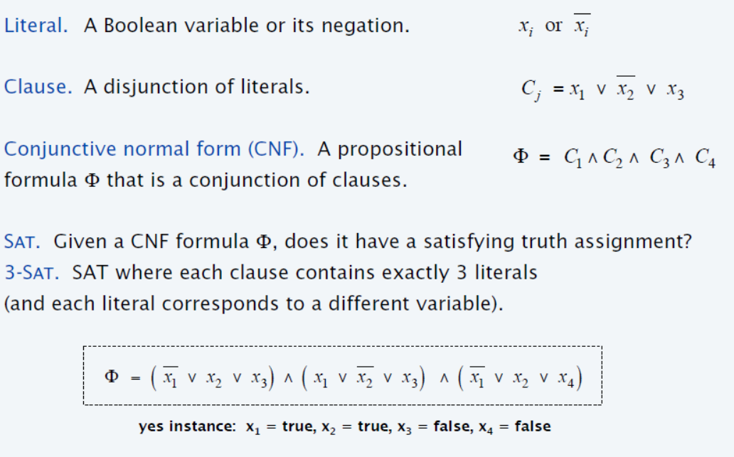
Satisfiability

Slide 24
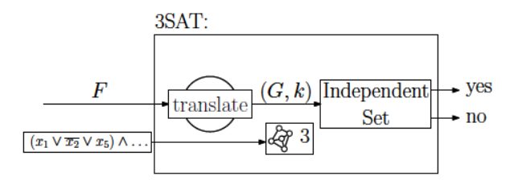
3-satisfiability reduces to independent set
if we could solve the independent set problem for G and k in polynomial time,
then we would be able to solve 3SAT in polynomial time.

Slide 25
Step 1. INDEPENDENT-SET ∈ NP
In polynomial time we can verify that, for each pair of vertices u, v ∈ S, S represents independent set.
There is no edge between them. (In particular, if G is given as an adjacency matrix, this can be done in O(n²) time.)

Slide 26
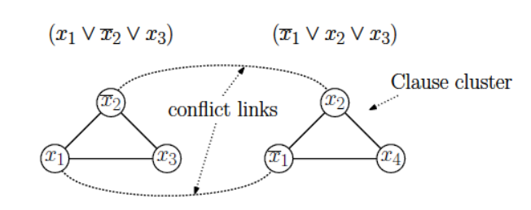
Step 2: 3-SAT ≤_{p} INDEPENDENT-SET
Reducing 3CNF to independent set (Construction)
G contains 3 nodes for each clause, one for each literal.
Connect 3 literals in a clause in a triangle.
Connect literal to each of its negations.

Slide 27
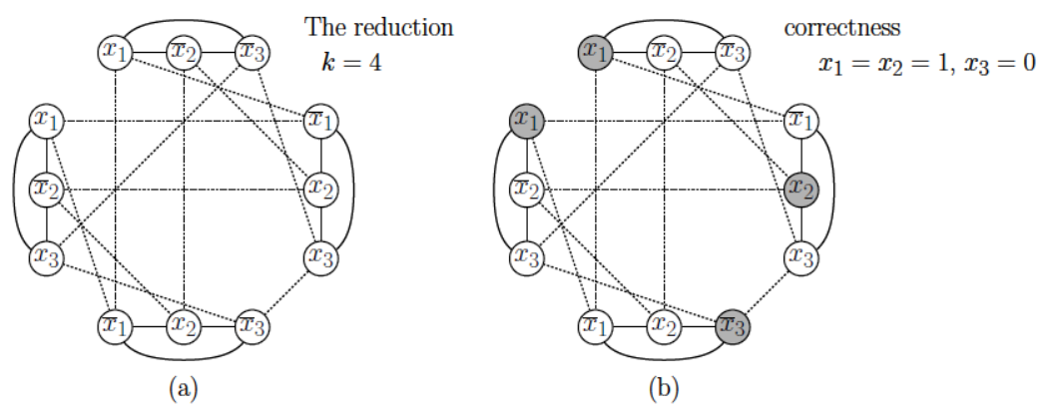

Step 2: 3-SAT ≤_{p} INDEPENDENT-SET
Literal $x_{1}$ satisfies the first and last clauses, $x_{2}$ satisfies the second, and $\overline{x_{3}}$ satisfies.
By selecting these vertices, we obtain an independent set of size k = 4.

Slide 28







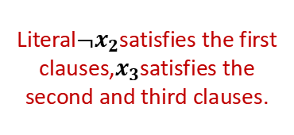
Step 2: 3-SAT ≤_{p} INDEPENDENT-SET
${¬x}_{2}=1 ;x_{3}$ = 1
$$x_{1}$$
$${¬x}_{2}$$
$${¬x}_{3}$$
$${¬x}_{1}$$
$${¬x}_{1}$$
$$x_{2}$$
$$x_{2}$$
$$x_{3}$$
$$x_{3}$$
Literal${¬x}_{2}$satisfies the first clauses,$x_{3}$satisfies the second and third clauses.
By selecting these vertices, we obtain an independent set of size k = 3.

Slide 29
3-CNF-SAT ≤_{p} Clique (Another SAT Reduction)
So steps to follow while reducing 3CNF to clique decision problem:
For each clause, create a vertex for each literal
For the edges, connect vertices if they come from different clauses (do not connect vertices in same clause)
No vertex (literal) should be connected to its negation in other clause.

Slide 30
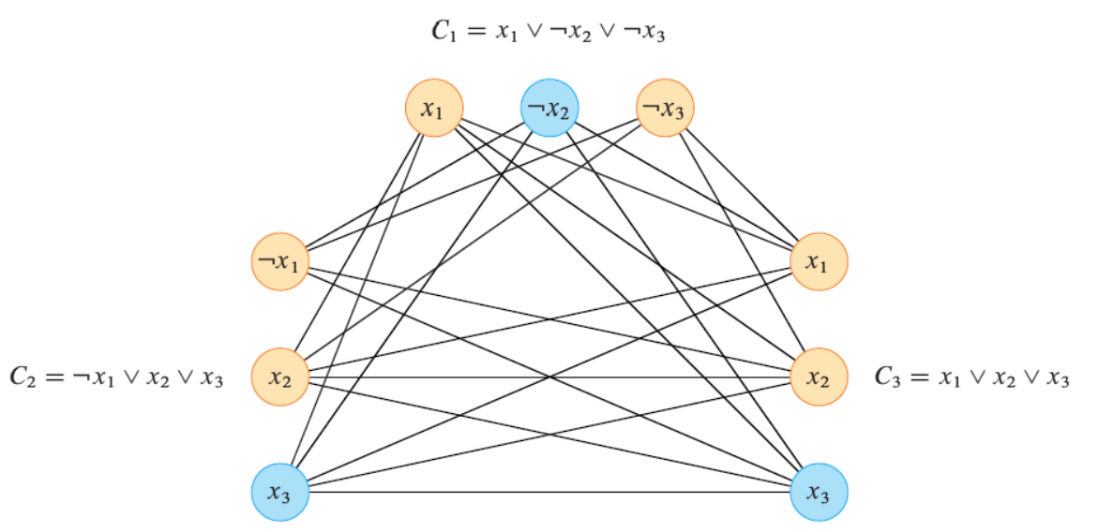

3-CNF-SAT ≤_{p} Clique (Another SAT Reduction)
By selecting these 3 vertices, we obtain the clique of size k = 3.
Literal$\overline{ x_{2} }$satisfies the first and, $x_{3}$ satisfies the second, and $\overline{x_{3}}$ satisfies third.

Slide 31
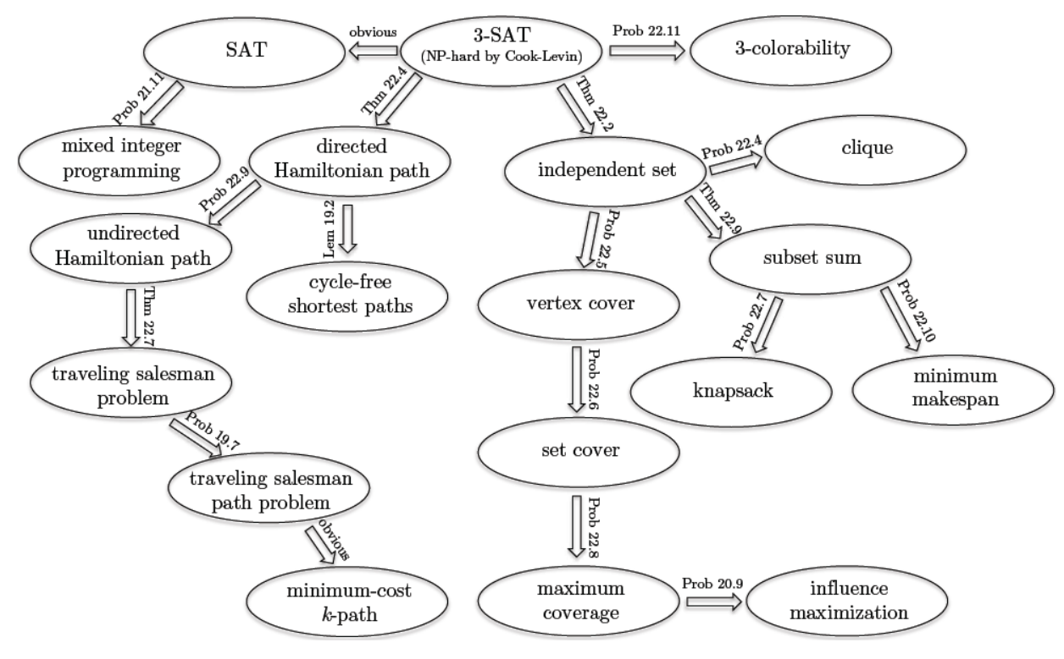
Cook-Levin theorem shows that 3-SAT is a “universal” problem

